Slide 1
Home work -3
Amit
Leibniz Universität Hannover

Slide 2
The motion of simple pendulum i.e. simple harmonic motion, can be represented with the following equation:
θʺ = - (g/l) × sin(θ)
where, g = acceleration due to gravity
l = length of the pendulum
θ = angle with the rest position
θʺ = double derivative of angle (angular acceleration)
Simulation starts with initial length (fixed), initial angle (which will be changing with time) and initial value of angular velocity (changes with time)
In order to find the solution to the second order differential equation (mentioned above) Runge-Kutta fourth order method (RK4) is used
The language used for implementation is Python
To animate the output Pygame library is used
Simple Pendulum Simulation (Vizualization)

Slide 3
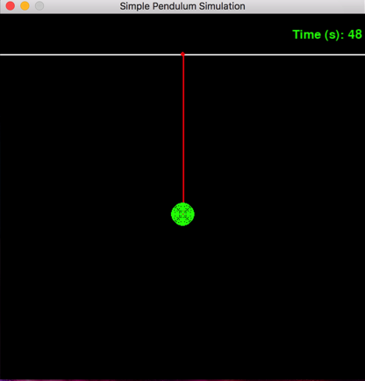
Results
(Initial Values: length = 100px, theta = pi/2, angular velocity = 0)

